Slide 1
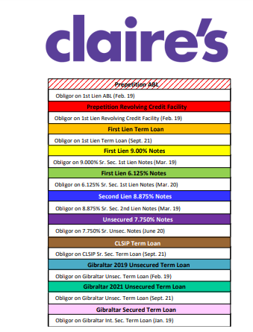

Slide 2
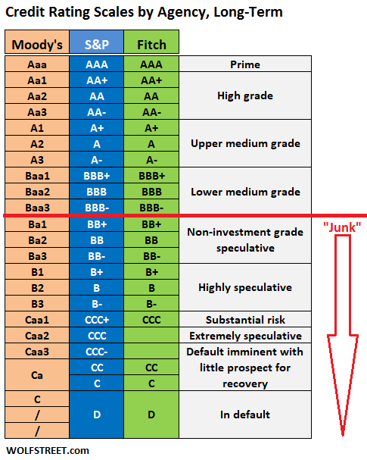

Slide 3
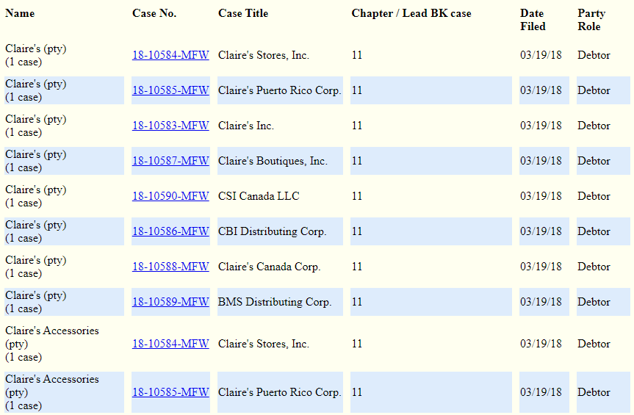
Case Filed!
This is what you see on the court’s website:

Slide 4
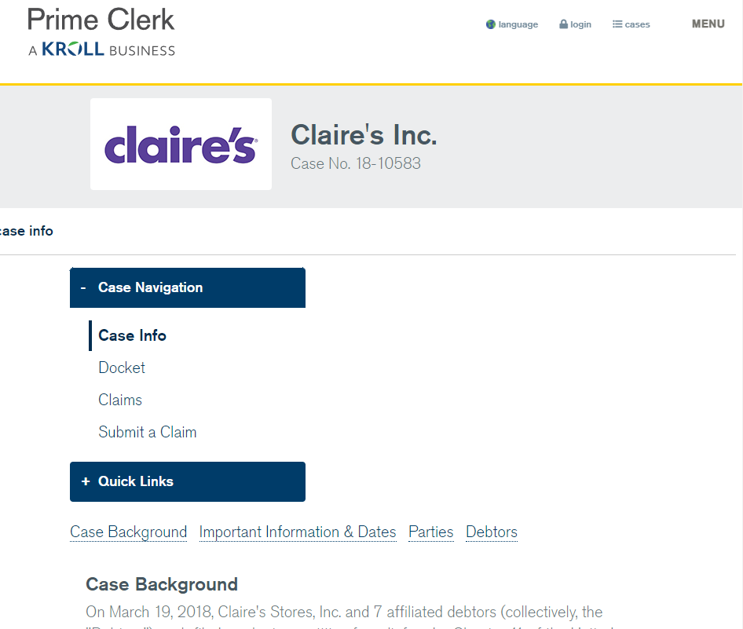
Claims Agents aka “Pacer is too Expensive”

Slide 5
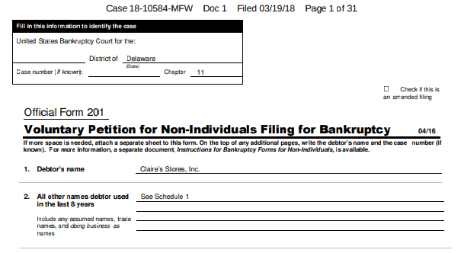
Find the Petition
The docket entry will look like this:
The petition starts off like this:

Slide 6
Look for the Total Debt

Slide 7
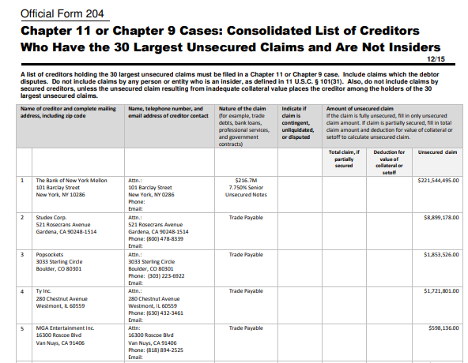
Creditors!

Slide 8
Shareholders!

Slide 9
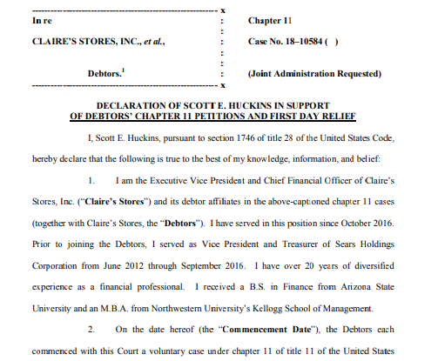
First-Day Declaration or “How We Got Here”

